Slide 1

Artificial Intelligence (AI)
Exploring Technologies, Real-World Applications & Career Pathways
Name: Rakshit Yadav
Roll No: 2501730016
Course: ETCCCP105 — Computer Science Fundamentals
Semester: 1

Slide 2

Artificial Intelligence Research and Analysis 2025: The New Frontier

Slide 3
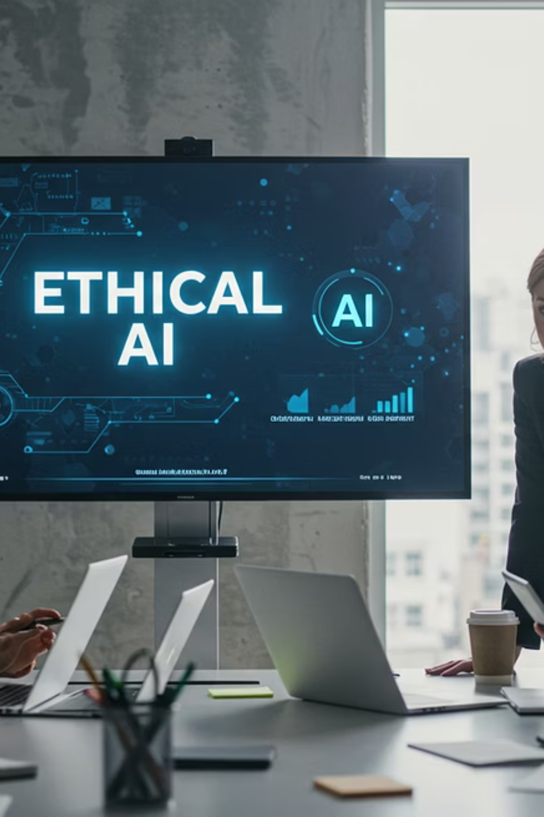

The AI Revolution: From Experimentation to Enterprise Impact
Artificial Intelligence is rapidly evolving from a niche technological curiosity to a fundamental driver of business transformation. Organizations globally are recognizing its immense potential, yet fully realizing that potential remains a significant challenge.
Widespread Adoption
Scaling Challenges
88% of organizations now regularly use AI in at least one business function (McKinsey 2025).
Only about one-third have scaled AI beyond pilots to enterprise-wide impact.
Transition Hurdles
The biggest challenge is transitioning from experimentation to true enterprise-wide transformation.

Slide 4

Breakthroughs Defining AI Research in 2025
The landscape of AI research is constantly shifting, with 2025 marking significant advancements in critical areas, pushing the boundaries of what intelligent systems can achieve.
Advanced Reasoning & Planning
Multimodal Integration
Multimodal AI seamlessly integrates text, images, audio, and video, leading to richer, more personalized user experiences (Google Cloud 2025).
Models now exhibit enhanced self-correction and operate effectively over long horizons, showcasing sophisticated reasoning capabilities (State of AI Report 2025).
AI as Scientific Collaborator
DeepMind’s "Co-Scientist" autonomously generates and tests hypotheses, particularly in complex biological research.

Slide 5

Multimodal AI: The Future of Intelligent Interaction

Slide 6
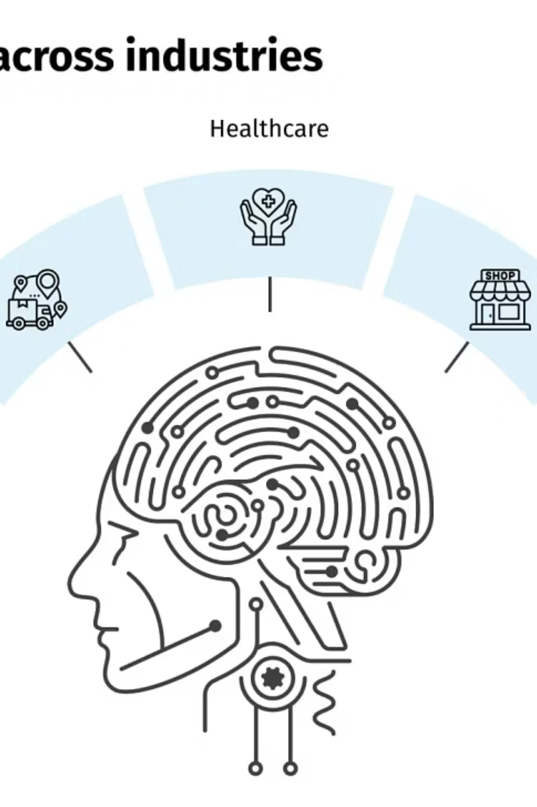
AI in Action: Transforming Key Industries
Artificial intelligence is no longer confined to research labs; it's actively reshaping operations and services across a multitude of sectors, delivering tangible benefits and driving innovation in real-world scenarios.
Healthcare & Biotech
Retail & Customer Experience
AI-powered diagnostics, personalized medicine, and accelerated drug discovery are revolutionizing patient care and R&D pipelines globally.
From intelligent chatbots to hyper-personalized recommendations, AI enhances customer journeys and streamlines e-commerce operations.
Manufacturing & Logistics
Predictive maintenance, supply chain optimization, and robotic automation boost efficiency and resilience in industrial processes.

Slide 7
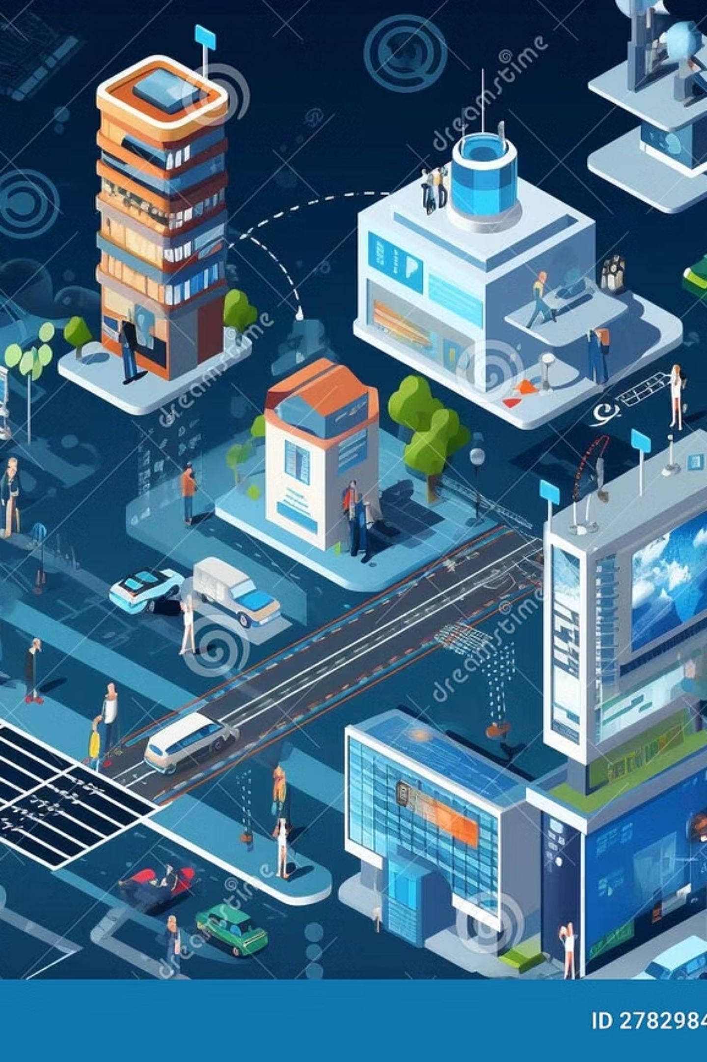
AI Usage in India: Regional Growth and Impact
India is rapidly emerging as a significant player in the global AI landscape, driven by government initiatives, a thriving startup ecosystem, and increasing corporate adoption. AI is being leveraged across critical sectors to foster innovation and enhance efficiency.
Digital Transformation Initiatives
Thriving AI Startup Ecosystem
Government programs like Digital India and initiatives focusing on AI for Public Services are accelerating AI adoption in critical sectors like healthcare, education, and smart city development.
India boasts one of the fastest-growing AI startup communities, particularly in FinTech, EdTech, and AgriTech, developing localized solutions that address unique market needs and challenges.
Enterprise Adoption & Skilling
Large Indian enterprises are integrating AI into their operations for enhanced productivity, customer engagement, and supply chain optimization, alongside significant investments in AI skill development.

